Slide 1
Error Handling
Execution
The import in SuccessFactors is successful
There’s an error in the data causing import to fail
There’s an error in SF data config that is causing the import to fail
The record has missing mandatory fields
Exception
There’s an error/exception in the interface
The CPI can not connect to source and/or target systems (SFTP and SF)

Slide 2
Paylocity

Slide 3
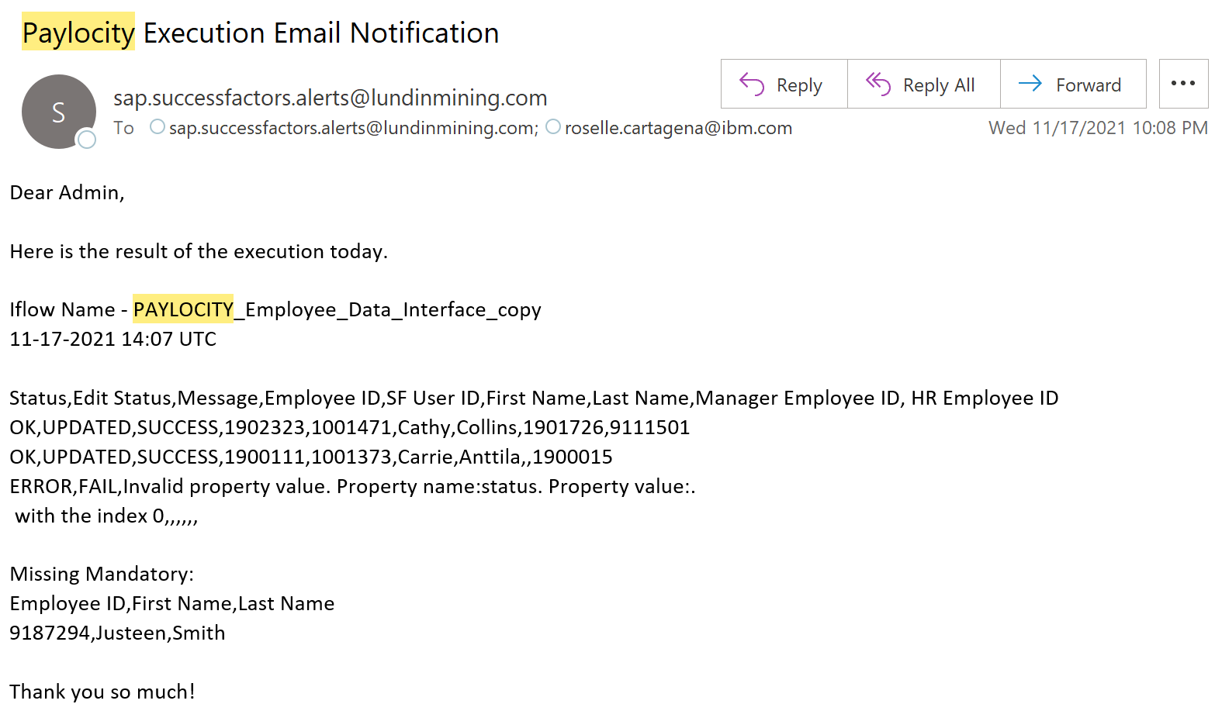
Import to SF

Slide 4
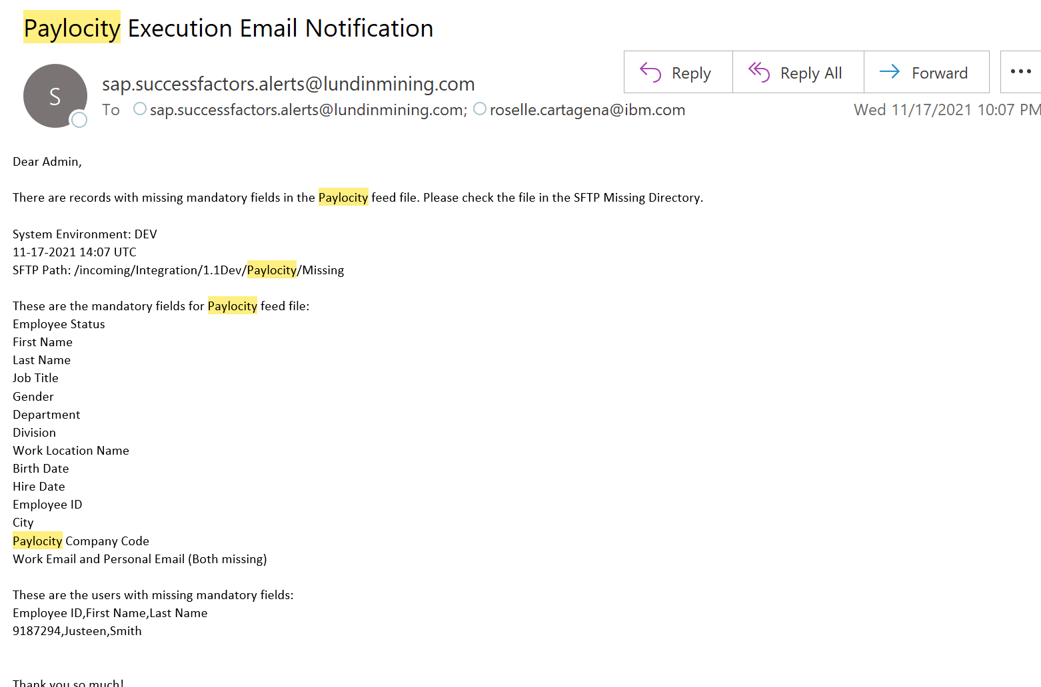
Records has missing mandatory fields

Slide 5
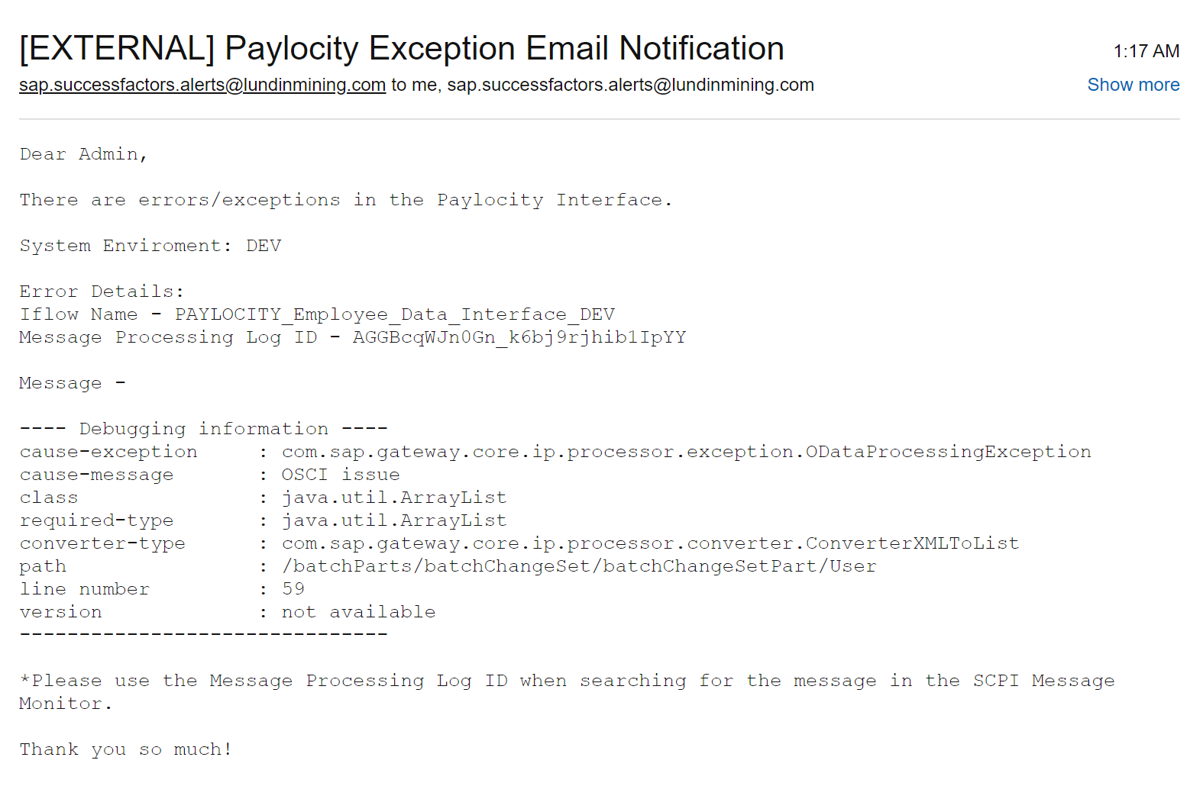
Error in the interface configuration

Slide 6
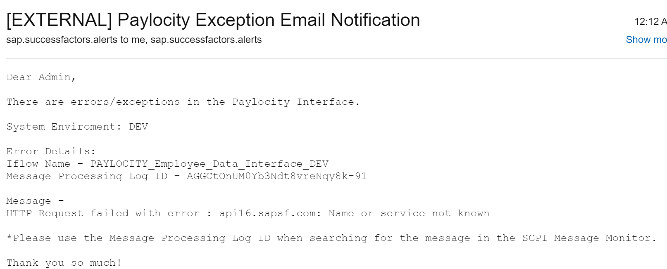
Error in the interface configuration

Slide 7
ADP

Slide 8
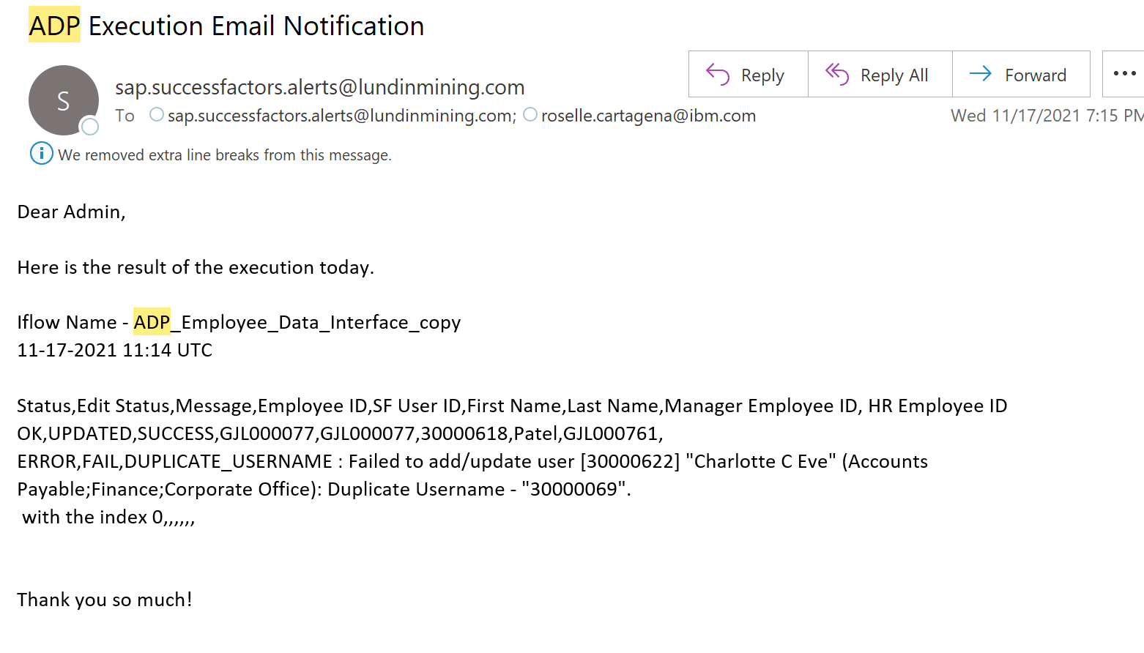
Import to SF

Slide 9
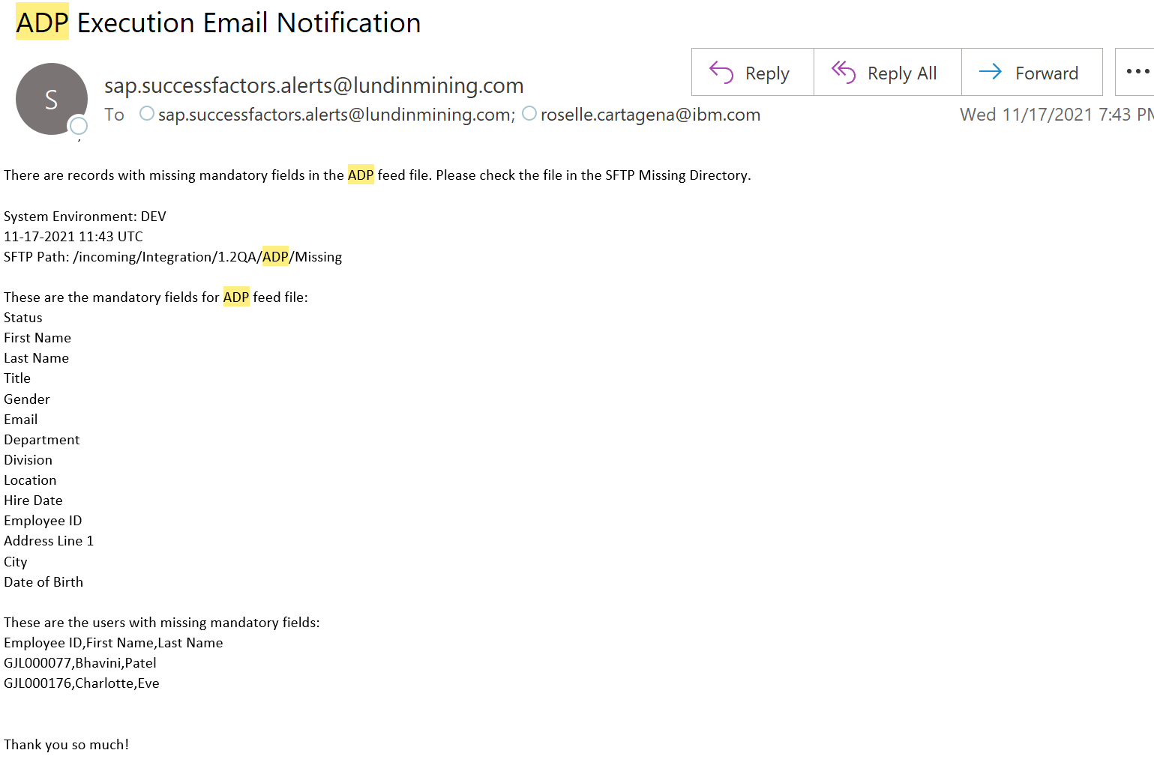
Records has missing mandatory fields

Slide 10
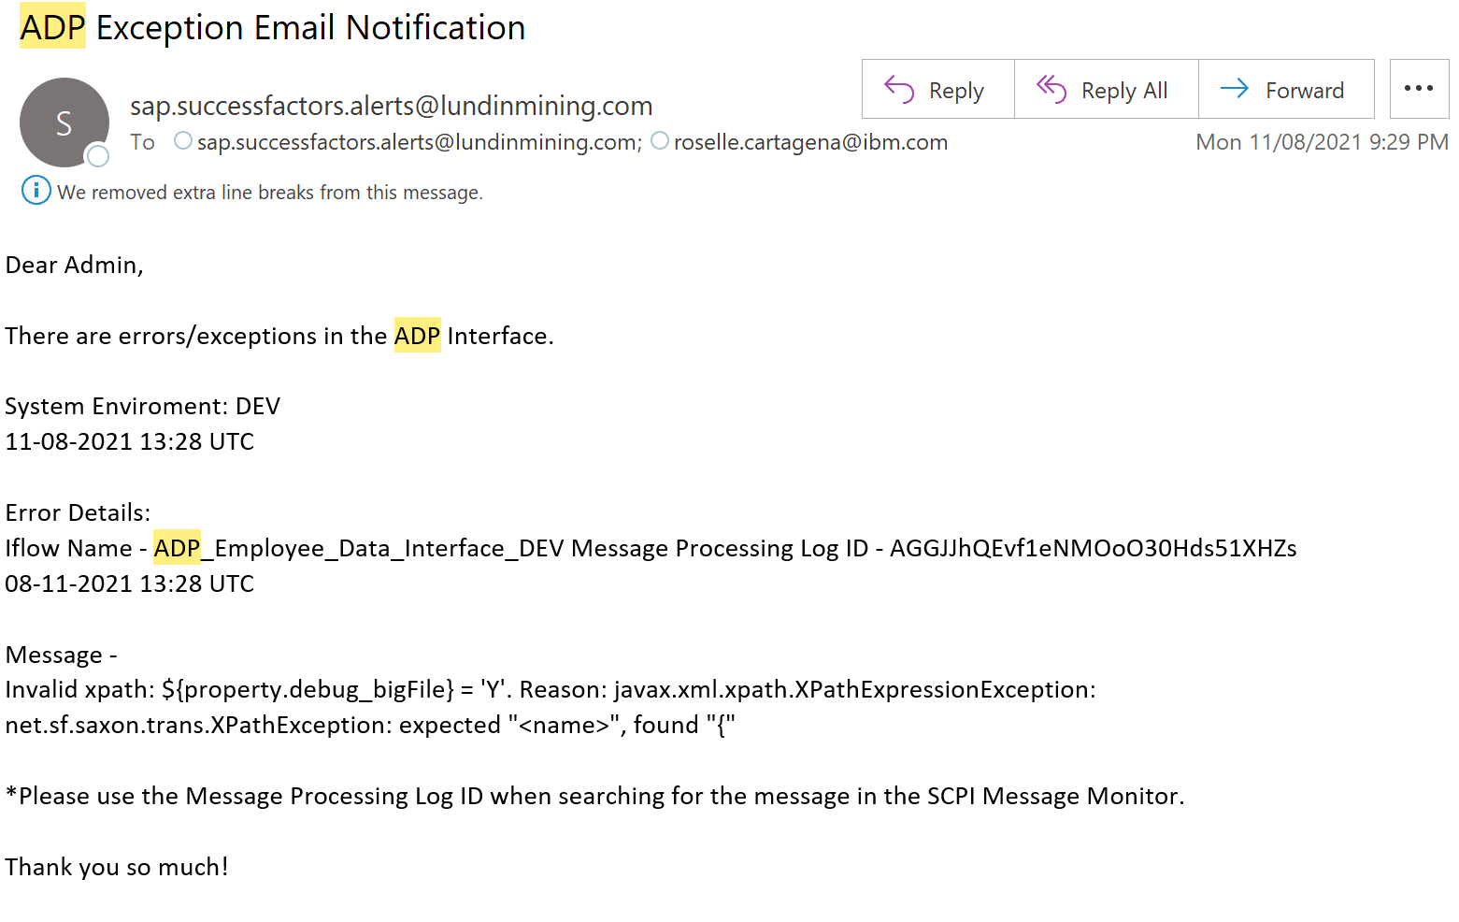
Error in the interface configuration

Slide 11
Somincor

Slide 12
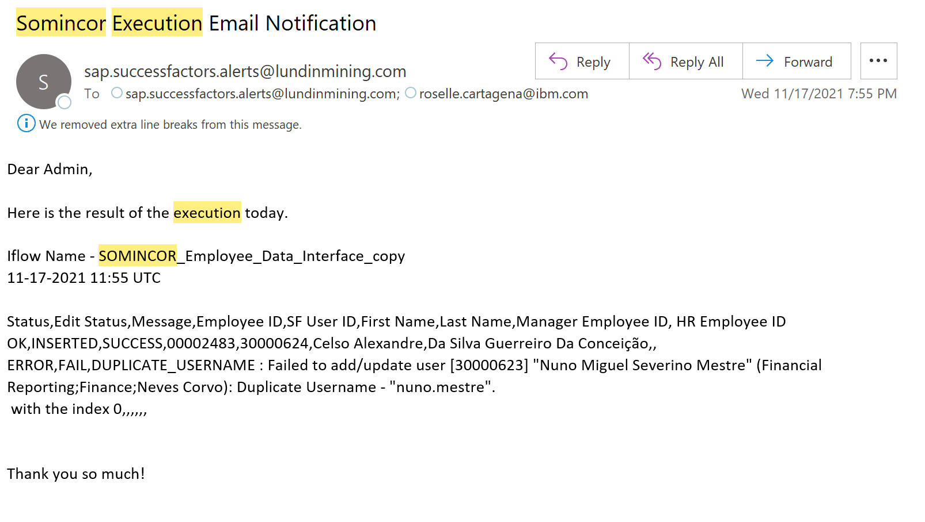
Import to SF

Slide 13
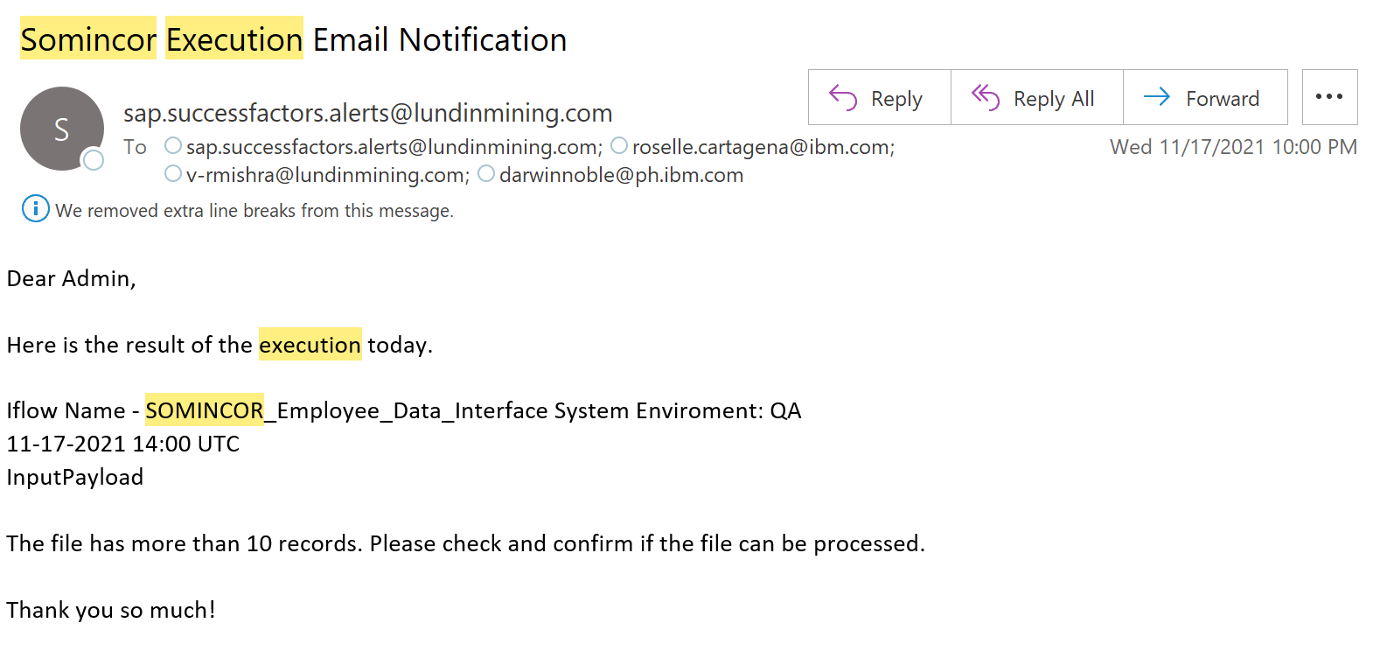
Big File

Slide 14
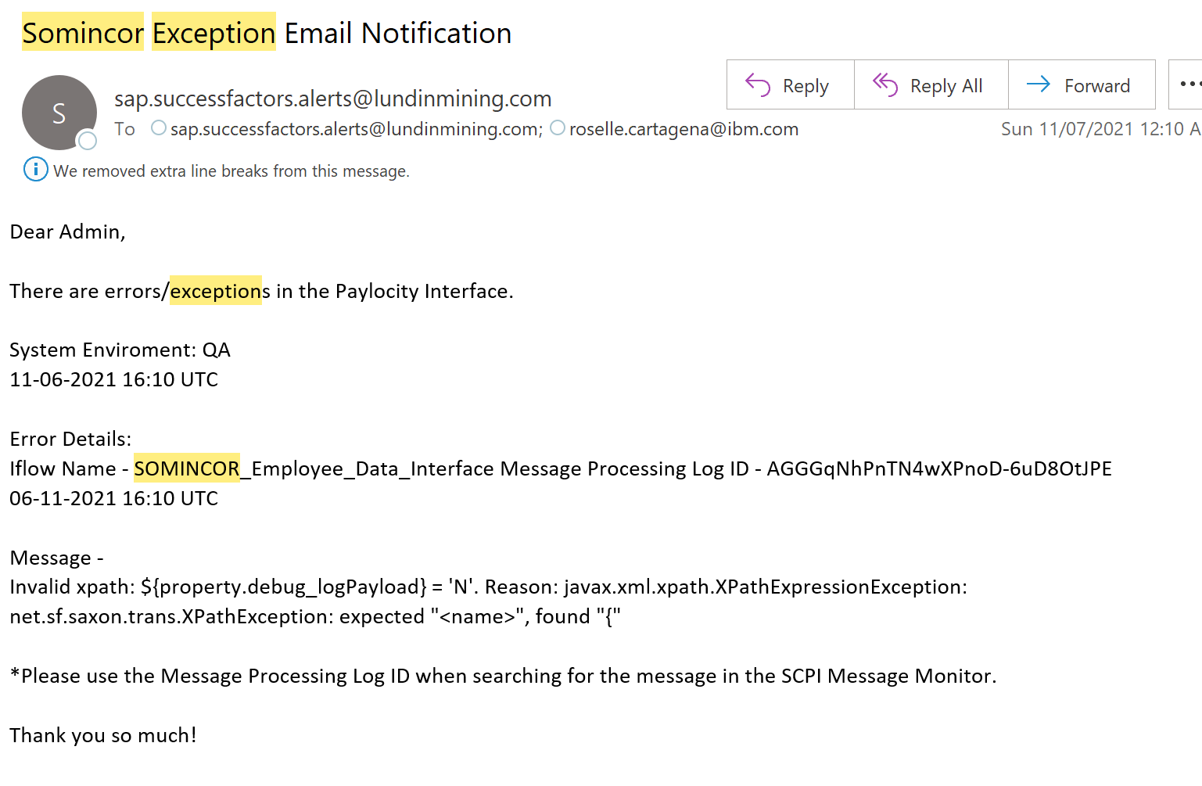
Error in the interface configuration

Slide 15
Candelaria

Slide 16
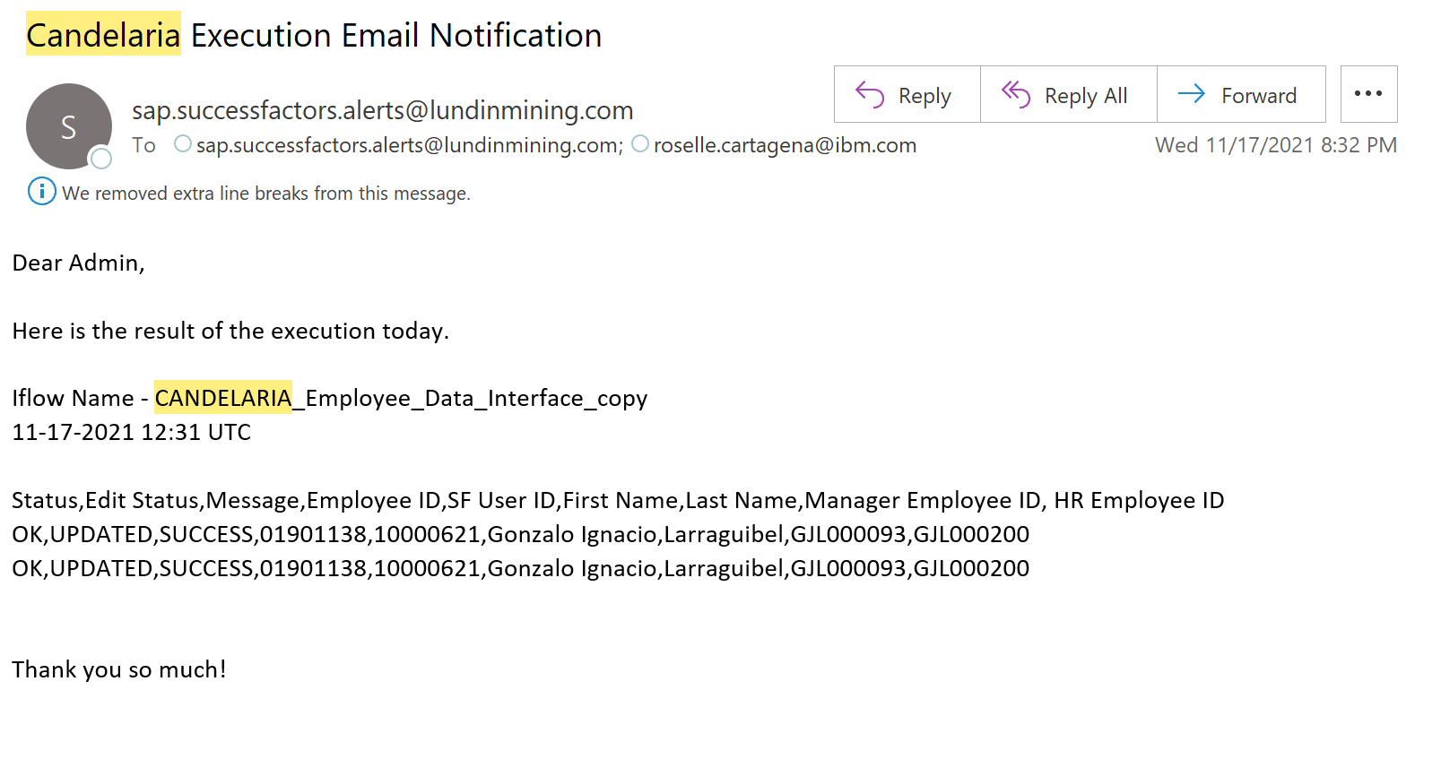
Import to SF

Slide 17
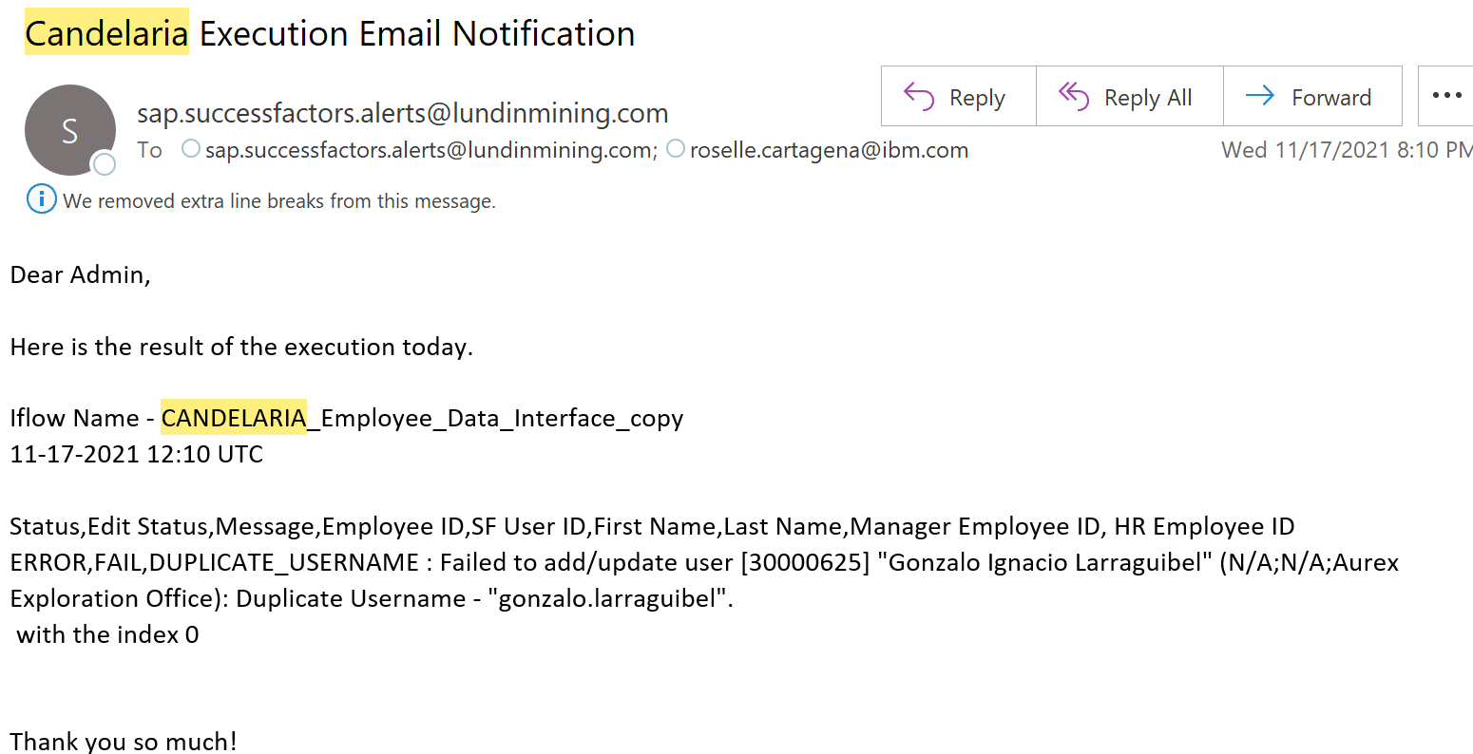
Import to SF

Slide 18
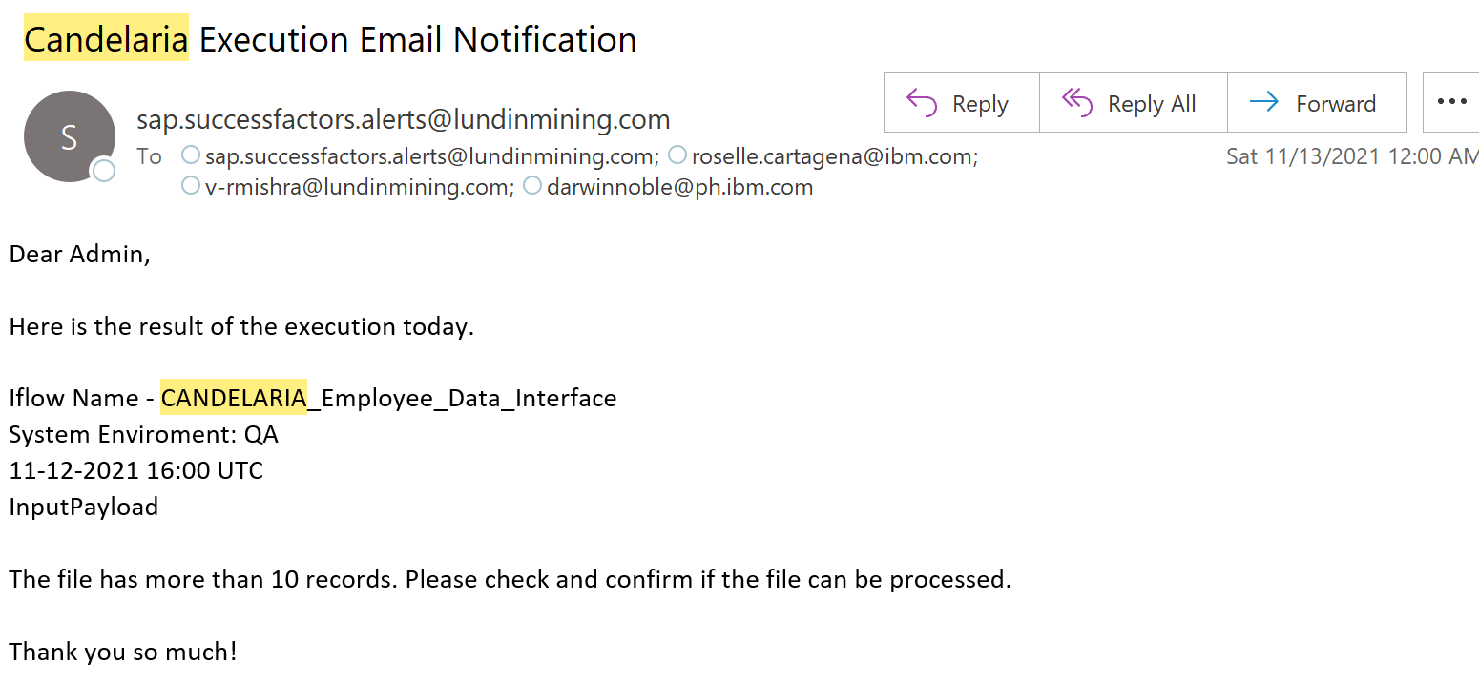
Big File

Slide 19
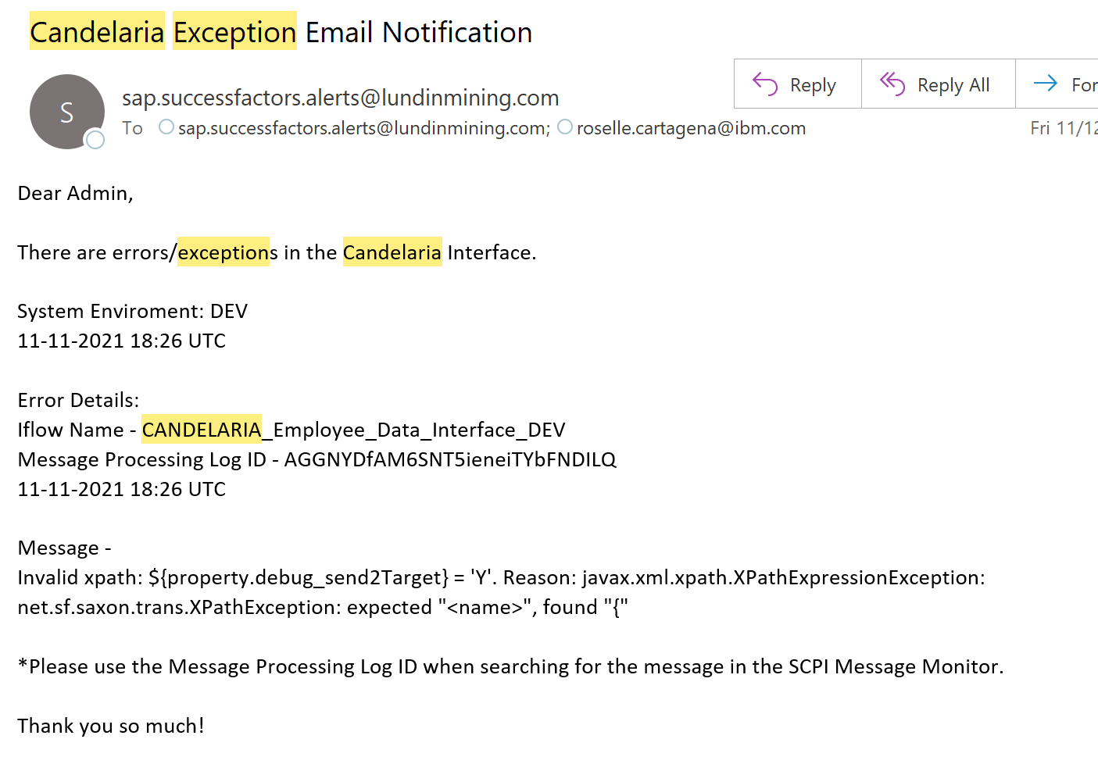
Error in the interface configuration

Slide 20
Datasul

Slide 21
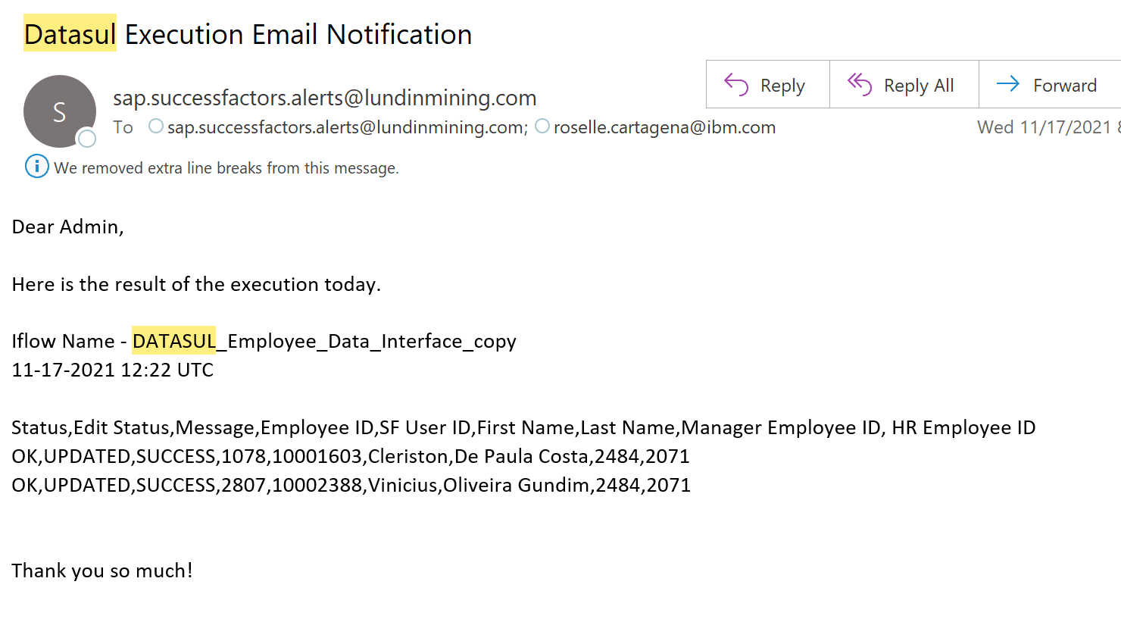
Import to SF

Slide 22
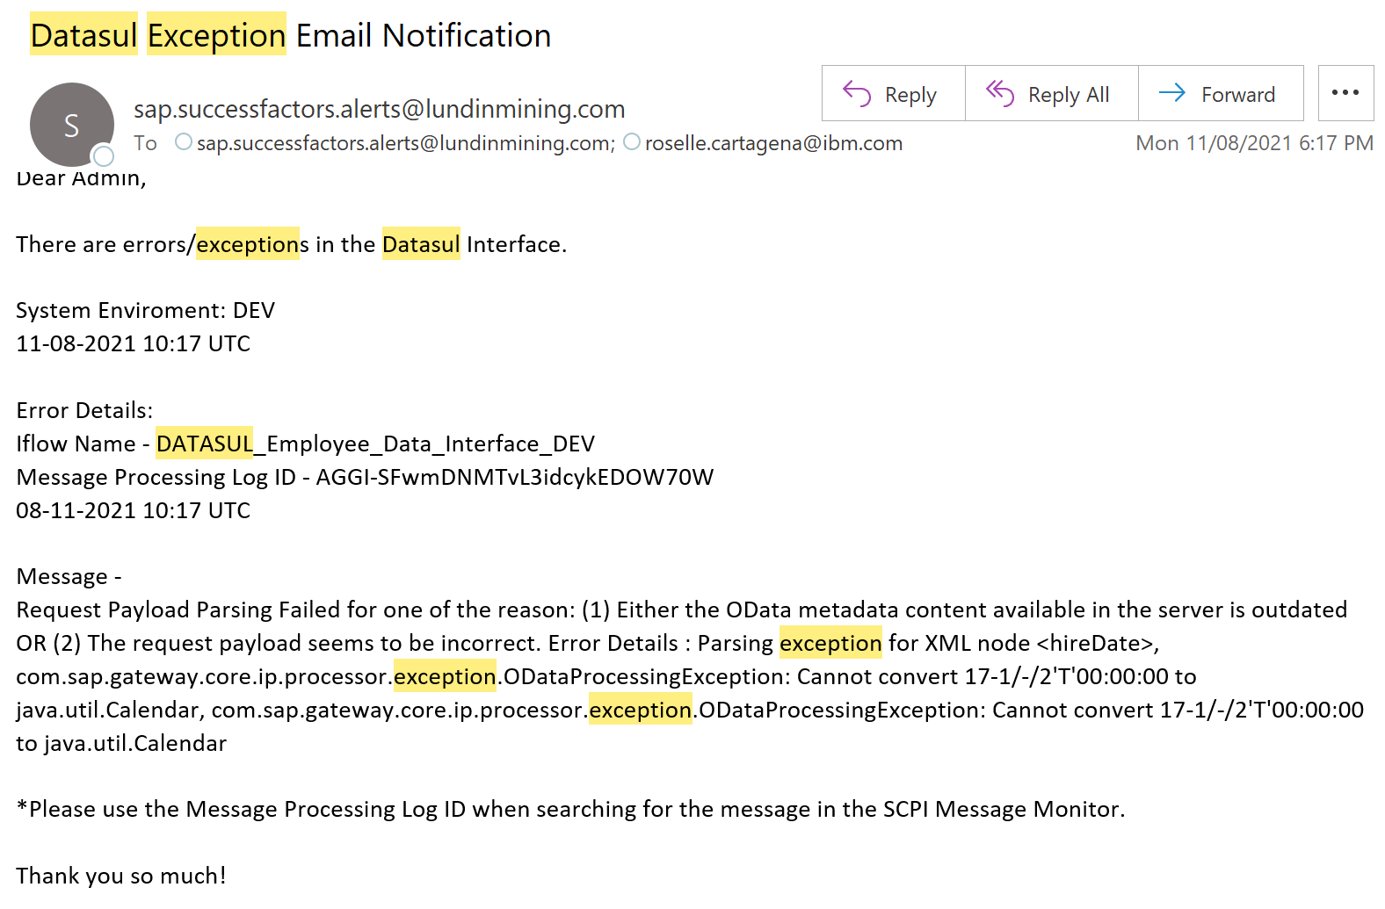
Data error – wrong date format

Slide 23
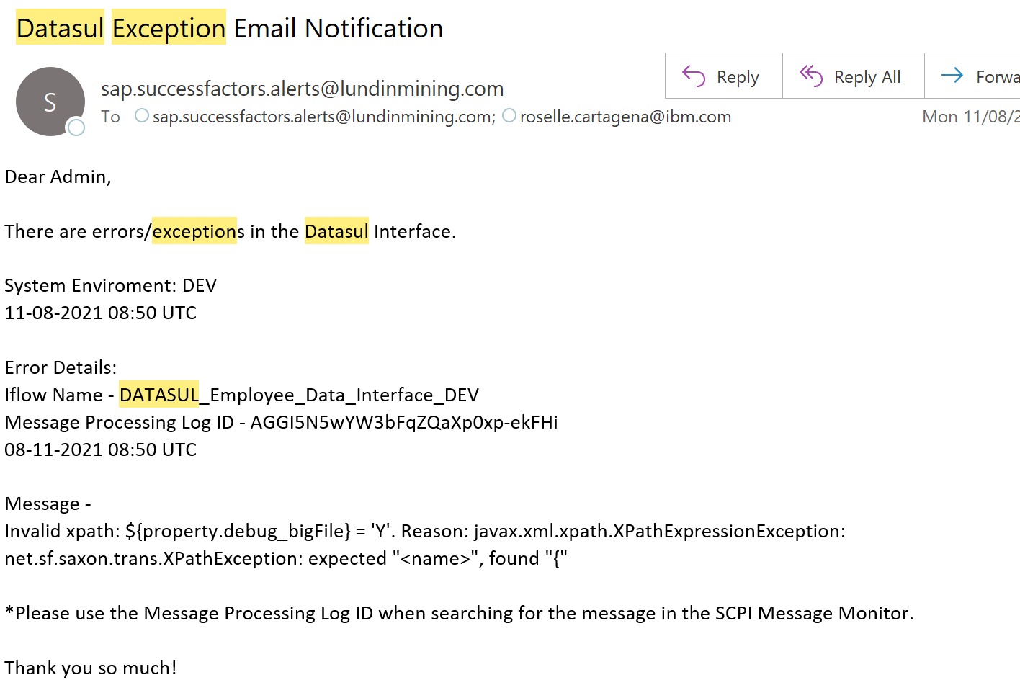
Error in the interface configuration

Slide 24
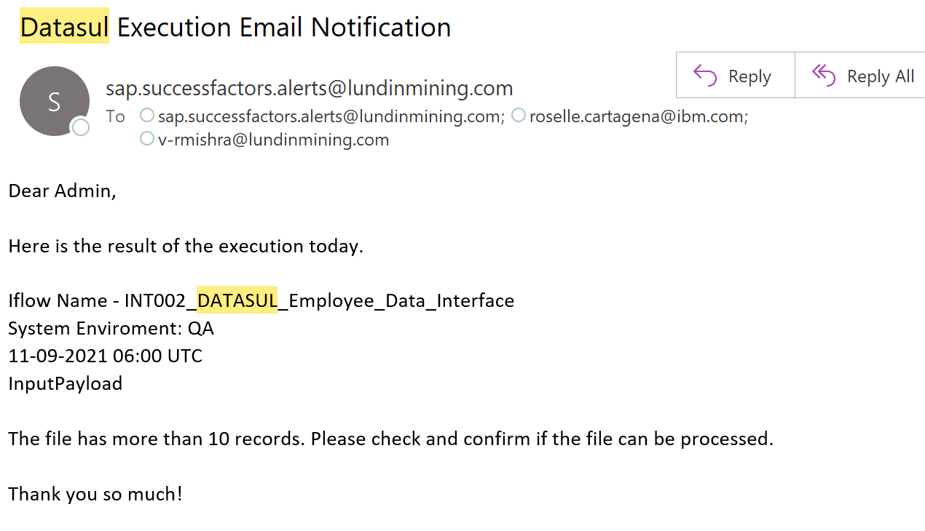
Big File

Slide 25
Visma Agda

Slide 26
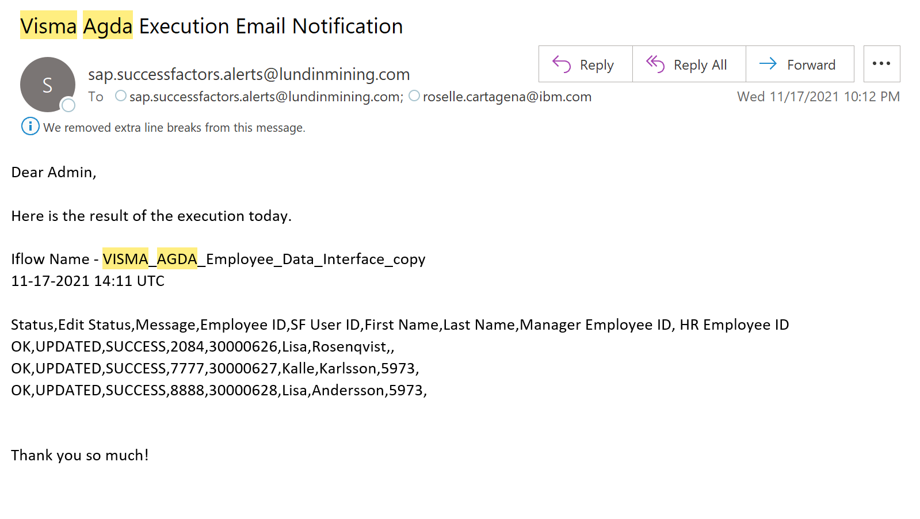
Import to SF

Slide 27
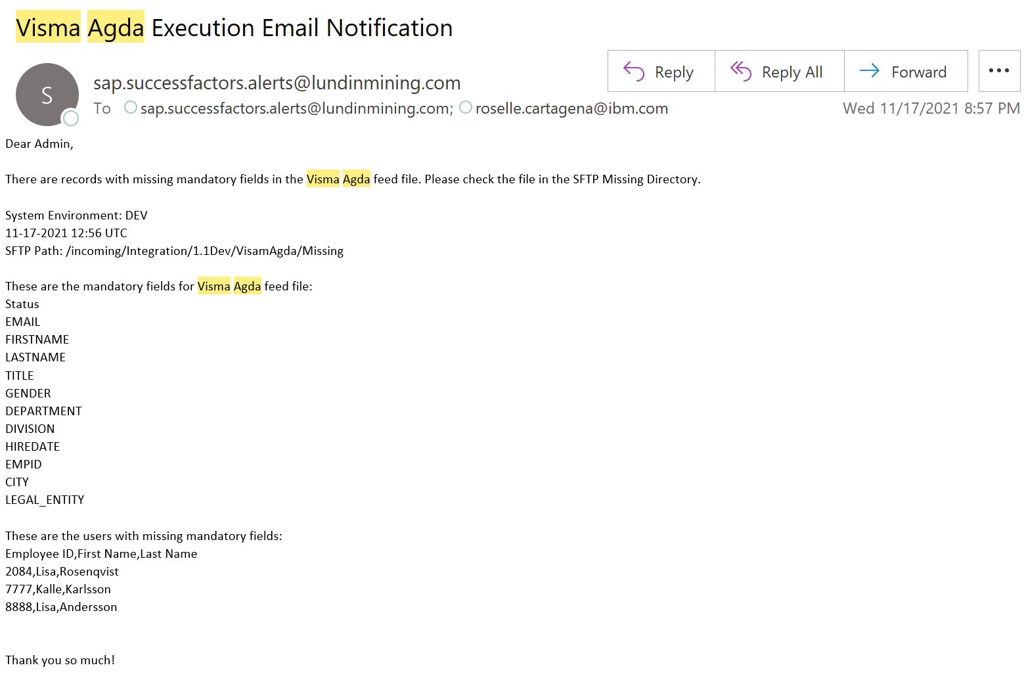
Missing Mandatory

Slide 28
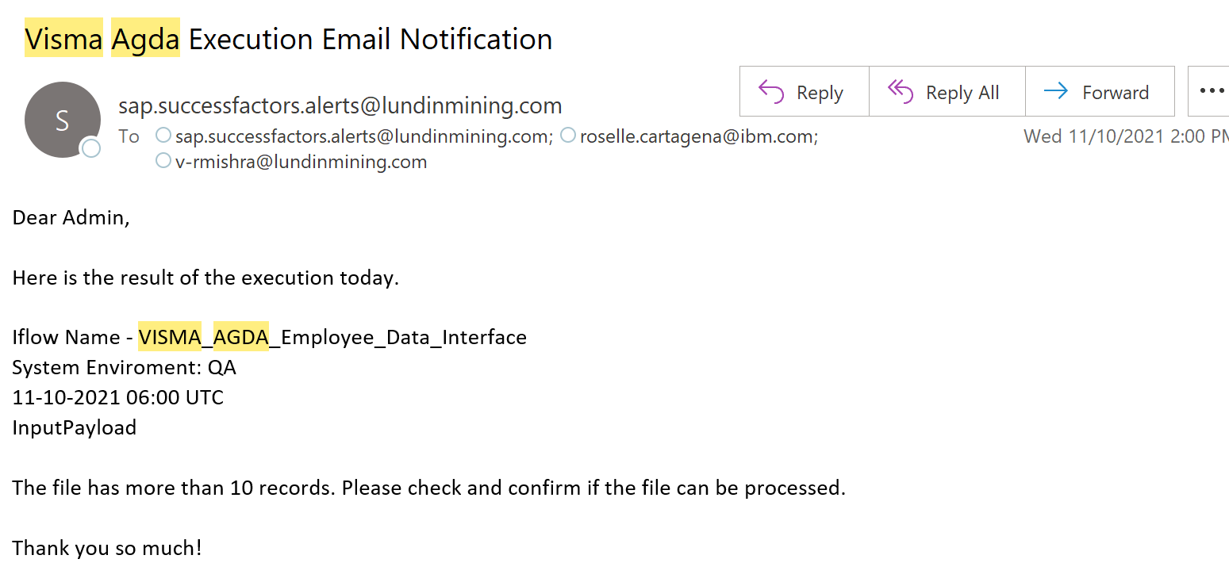
Big File

Slide 29
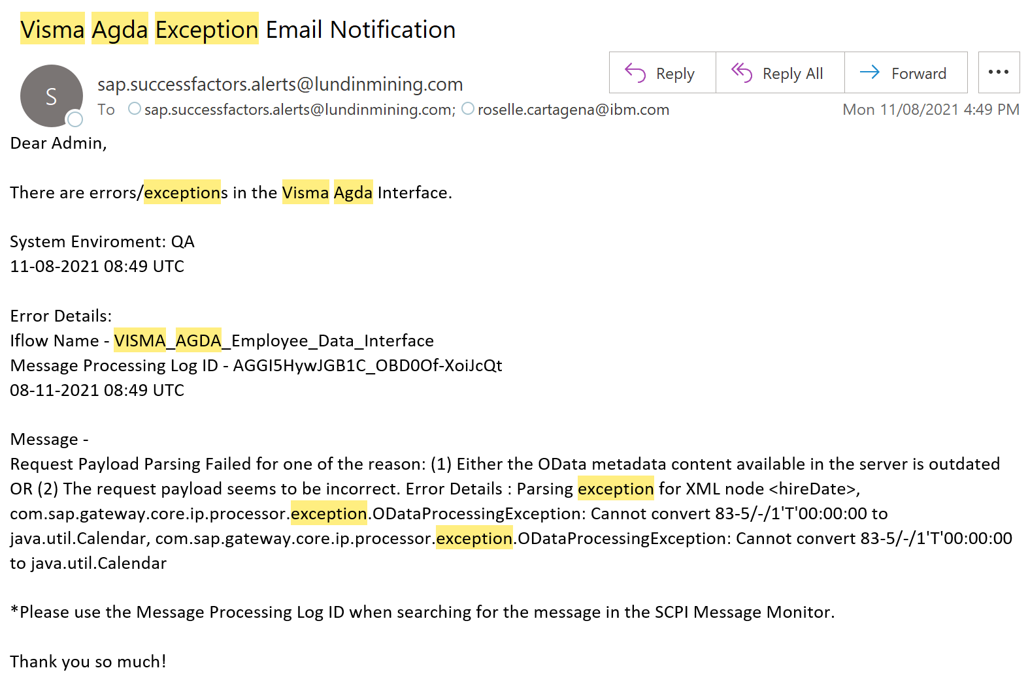
Data error – wrong date format

Slide 30
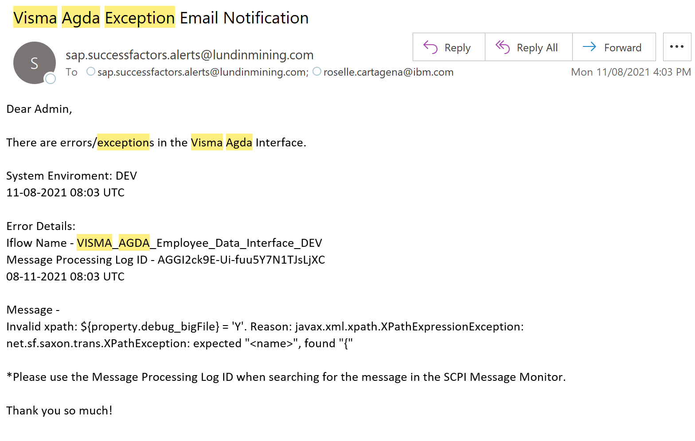
Error in the interface configuration

